Slide 1

Business email

Slide 2
Steps to consider before and While writing an email

Slide 3

1. Find Your Business Email Audience
Not all email audiences are the same. For that reason, not all business email should be formatted and written in the same way. Some business email should be structured in a more formal style. But, if you're more familiar with your recipient, it's okay to structure your email in a less formal style.
The email style you choose determines your email opening and closing. It can also determine the language you use and the tone of the email.

Slide 4
USE A FORMAL EMAIL STYLE
If it is required in your organization
If the recipients are not well known to you
USE AN INFORMAL
EMAIL STYLE
If it is encouraged in your organization (your boss and others use an informal style)
for a business colleague who is well-known to you and/or on friendly terms
If you are sending email to your boss or teachers

Slide 5
2. Know the Structure of a Business Email
Subject Line
Integral part (noticed instantly
Should be specific and precise (6-10 words)
Salutation
How you greet the recipient
Depends on the relations with the recipient (known/unknown)
Body Text
Conveys main message of the email
Should be in paragraphs (bullets if needed)
Signature
Should be clear
Add a good signature that will provide all the information about you to the reader

Slide 6
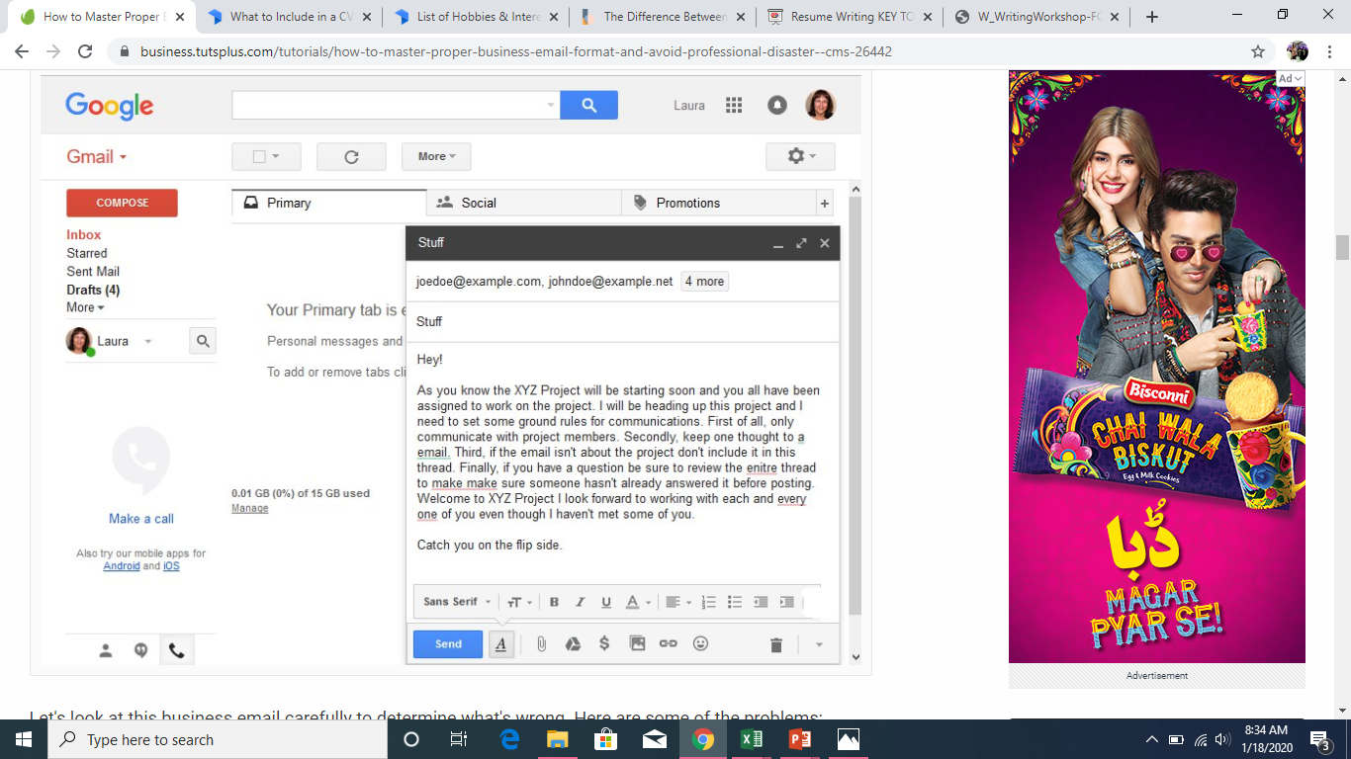
3. The Problem With formal (sample) Email

Slide 7
Issues with the formal (sample) email
Subject Line. The subject line "Stuff" is too short and too vague. It consists of only a single word. With this subject line, some email systems may even send it straight to the spam filter.
Salutation. The salutation of "Hey" is too informal for an introductory message like this. The email author mentions they've never met some of the team members.
Body Text. The body of this email is one giant paragraph. That makes it hard for the average reader to follow. The body also includes items that would be better if they were formatted as a list.
Typos and Grammar Problems. The body text includes several poorly worded phrases. There are some run-on sentences. There are also typos and even a repeated word, “make make.”
Poor or No Closing. “Catch you on the flip side” is too casual of a closing for most business emails.
Signature. There's no signature for this email. If the team is a new one, they might wonder who the sender is.

Slide 8
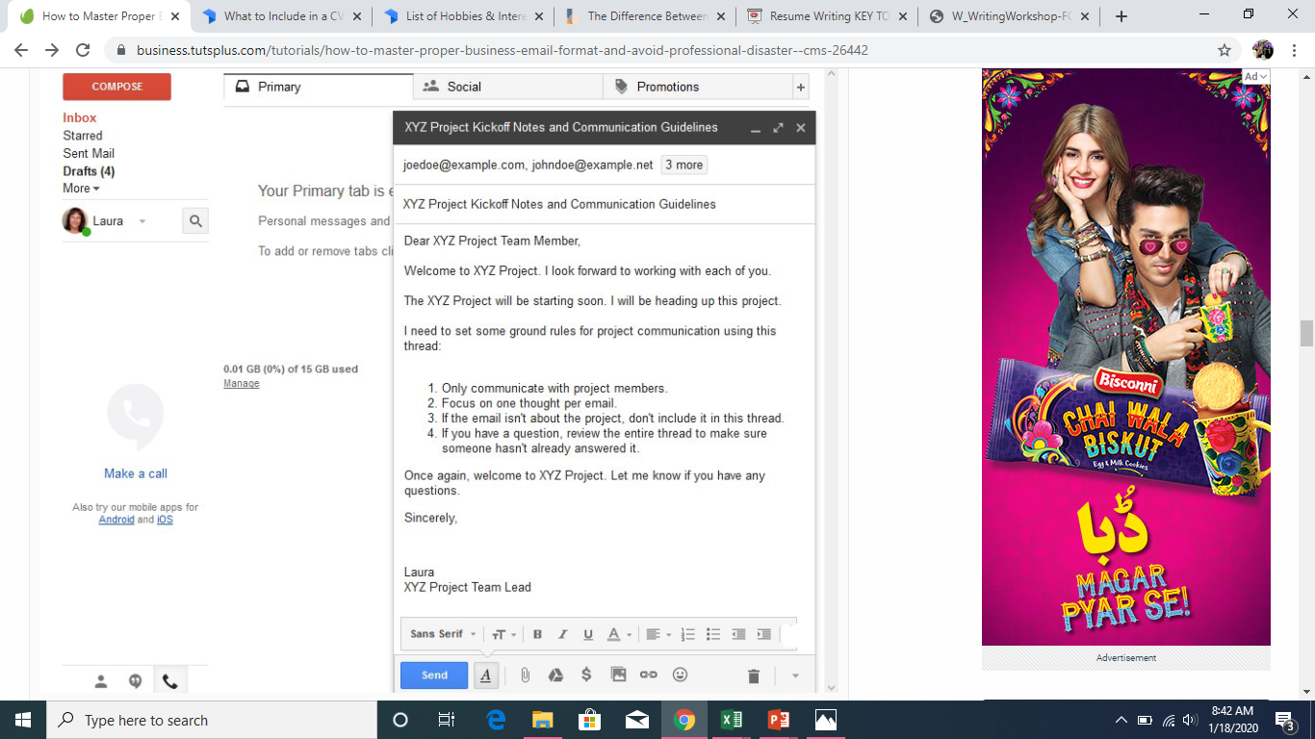
After the editing

Slide 9
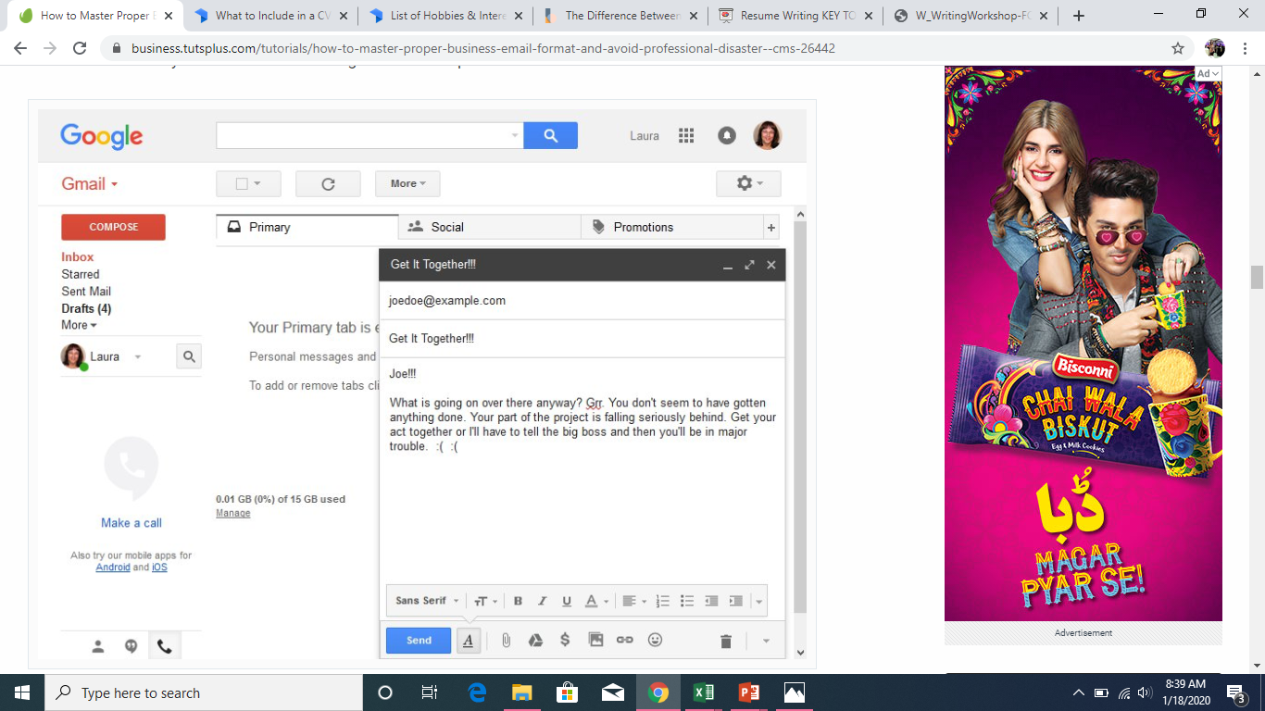
4.Problems with informal (sample) email

Slide 10
Issues with the informal (sample) email
Subject Line. The subject line "Get It Together!!!" is a little bit too short. It's also vague and accusatory.
Salutation. The salutation of the person's name is not horrible for an informal email. However, the three exclamation points add an unneeded angry or upset tone.
Introduction. There is no introductory paragraph in this email.
Body Text. The body text is all one paragraph. It is written in an angry tone with phrases like "Grrr" which aren’t helpful. It also includes emoticons, which are not generally acceptable in a business email.
Conclusion. There's no concluding sentence. The recipient may be unsure of what to do next.
Signature. There's no signature in this email.

Slide 11

After the editing

Slide 12
How to avoid email disaster
Don’t Rush. A hurried email is often a badly formatted, badly written email. Allow yourself enough time to properly format every email you write.
Avoid Emotion. It’s never a good idea to send out an email when you're upset.
Be Concise. Use short sentences and short paragraphs. If appropriate, make use of bulleted or numbered lists.
Review. Double-check your email for typos, grammar mistakes, and other errors. It’s also a good idea to make sure all the parts of the email are included.

Slide 13
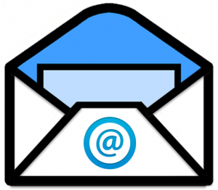
Activity
Write an email to the finance head of your company Ms Jennifer, suggesting her few rectifications in the annual budget report that has been sent to you.

